Slide 1
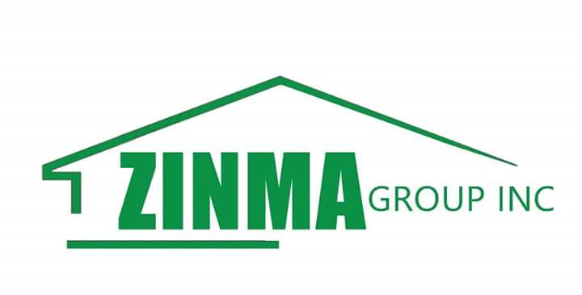
Profile
Of
ZINMA GROUP INC.
Perry & Camp Johnson Road
Monrovia, Liberia
Email:
Website:

Slide 2
About the Founder
From a humble background, Abraham Bemah today finds himself heading a first-class construction company that is among the top ten Liberian owned construction companies in Liberia. He grew up like impoverished youths in the country. He obtained his education from the Salvation Army School system on the Pipeline Road, Paynesville, Liberia and later to the Booker Washington Institute where he obtained a Diploma in General Construction.
The intensity of the Liberian Civil War forced Abraham to travel to Nigeria where he did casual jobs while residing in Lagos. Upon returning home in 2000, he advanced his education in General Construction and worked at several institutions all the while saving more than 80% of his income to set up ZINMA GROUP INC., a dream he had harbored since his teens.
As CEO of ZINMA GROUP INC. I am proud to be among the Liberians that are doing exploits in this nation by lifting Liberia up on the world market both in infrastructure development and the empowerment of Liberians when it comes to job facilities and by the grace of God we are getting there.

Slide 3
What the company does
ZINMA GROUP INC. has effectively positioned herself as a leading construction company and is engaged in: General Construction, Renovation, Repairs, Road Construction, Maintenance, Transportation (big and small cars), Garbage Disposal, General Maintenance & other services.

Slide 4
STRATEGY
a. Vision Statement
Making Liberia own business as #1 in our nation and the world.
b. Mission Statement
Putting our hands and minds to work
c. Business goals & objectives
To help develop Liberia in a standard way as compared to other western countries around the world when it comes to infrastructure development.
d. Business Strategy
Media publicity, flyers, business networking and advertising.

Slide 5
VALUES
Wherever in the world it operates, ZINMA GROUP INC strives to live by its core values of:
People
Excellence
Transformation
Customer Focus
Innovation
Integrity and
Performance

Slide 6
Current Customers & Projects Completed
NAMES | PROJECTS | COMMENTS | COST
MCC (Monrovia City Corporation) | Laying of tiles on the walls and pillars of MCC main building | Completed | $9,000 March- April 2016
MCC (Monrovia City Corporation) | Changing of ten damaged square bar windows at MCC | Completed | $4,000 April 2016
FDA (Food and Drugs Agency) | Painting and installation of two air conditioners | Completed | $900 June 2016
FDA (Food and Drugs Agency) | Welding the leakage of two containers | Competed | $500 April 2016
Remedy Movement International | Construction of a multi-purpose building | Completed | $1,200,000 February – July 2016
Remedy Movement International | Construction of a 28 apartment building | Completed | $1,500,000 November 2016- present

Slide 7
Machinery or Equipment
NAME | # OF EQUIPMENT | OWNED/RENT | COMMENTS
Mercedes truck, ten tires | 1 | Owned | Good working condition
Caterpillar | 1 | Rent | Good working condition
Cars | 3 | Owned | Good working condition
Excavator | 1 | Rent | Good working condition
Bulldozer | 1 | Rent | Good working condition
Concrete mixer | 1 | Owned | Good working condition

Slide 8
Office and Administration
NAME | POSITION | CONTACT
Abraham Bemah | Chief Executive Officer (CEO0 | 0886949896/0770949896
David Wiles | Operation Manager (OM) | 0886279869
Emmanuel Johnson | Chief Engineer | 0886723816/0775570279
George Thomas | Engineer | 0775579639
Magdaline Doegoliah | Financial Manager | 0880790031

